Slide 1
Vectors
By: L Vinay Rajiv Reddy

Slide 2
What is a vector ?
Vector is a quantity which has both the magnitude and direction.
Length (l)

Slide 3
Types of vectors
1) Unit Vector : Vector having magnitude equals to 1.
2) Co-initial Vectors : Vectors having same initial point are called as co-initial vectors.
3) Collinear Vectors : Vectors parallel to each other are called collinear vectors.
4)Equal Vectors: Vectors having equal magnitude and same direction.
5) Negative Vectors: Vectors having equal magnitude but exactly in opposite direction.

Slide 4
Addition of 2 Vectors
AB + BC = AC
C
AC
BC
A
B
AB
-BC
C

Slide 5
Multiplying a Vector by a Scalar
a ➔
2a →
-0.5a ➔

Slide 6
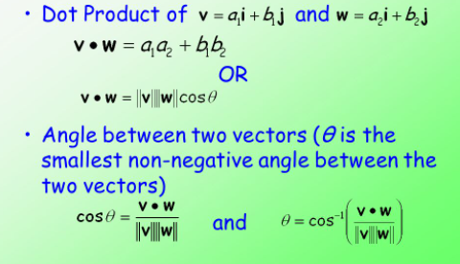
Dot Product of 2 Vectors

Slide 7
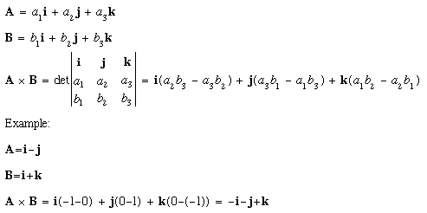
Cross Product of 2 vectors

Slide 8
Equation of Straight Line
Y= mX+ C
m → Slope
C → Intercept of line on Y axis.

Slide 9
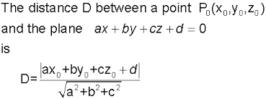
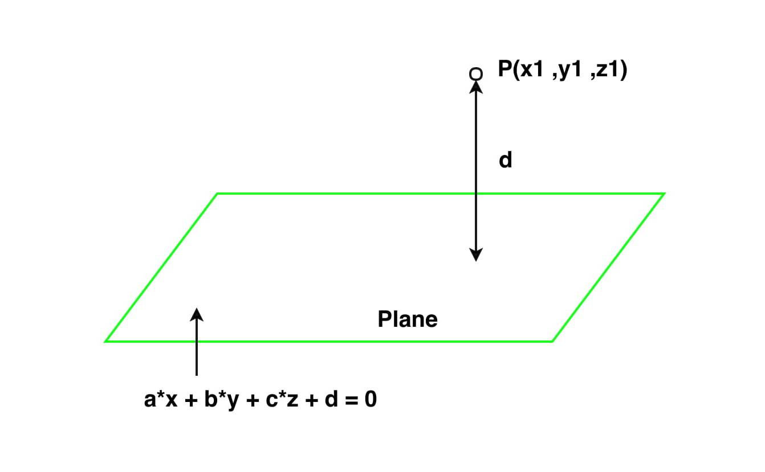
Distance b/w a point from plane

Slide 10
Equation of a plane
if any plane P passes through the point (x1,y1,z1) and the vector normal to it is aiˆ+bjˆ+ckˆ
then its equation is given by,
P:a(x−x1)+b(y−y1)+c(z−z1)=0

